Slide 1



Benefit Update – Running Benefit Workshops
Stephanie Chadwick
Spetember 2022
1.0
Version | Date | Updated by: | Summary of changes
1.0 | 29/09/2022 | Steph Chadwick | Initial Baseline date of document

Slide 2
Benefit Update
Running Benefit Workshops – When, Why, Who & What

Slide 3




Running a benefit workshop
When? Do it as early as is practically possible in the Define stage and revisit when required.
Why? Validated information and evidence for the Business Case
Who? Include SMEs and Business Leads.
What? Expected measurable improvements, strategic alignment, key deliverables and milestone information
Notes:
Assess and validate benefits as early as is practically possible in the Define stage and revisit as and when required during the current stage and future stages to assess any impact on benefits from changes in scope and to identify if there are any emergent benefits.
Ensure the right people attend, this will vary from project to project but should include SMEs from the relevant business area.
Encourage discussion and conversation about the improvements that are expected to occur as a result of the project and summarise discussion points on post it notes or the digital equivalent.
Start to categorise the information by asking questions like ‘Is this a one off event?’, ‘Can this be measured?’, ‘How is this different from what we have now?’.
List the information under the headings; benefit, change, deliverable, objective and then start to link the information together and show the links to the University strategic objectives.
Allocate benefit owners in the business who will be able to embed the changes and realise the benefits.
At the end of define stage you will have a benefit map which will show the benefits, changes, deliverables and objectives, this information should then be used to populate the benefit log and then the information can be used in other templates.

Slide 4
Running benefit workshops – When?
Define
Design & Plan
Readiness
Implement, Review and Close
Gateway 2 – Outline Business Case
Confirm and update benefits with stakeholders
Gateway 3 – Full Business Case
Gateway 4 – Pre-implementation approval
Gateway 5 – Initiative & Benefit Review
Run initial workshop with key stakeholders
Identify any emergent benefits
Ensure benefits are on track to be realised
Validate information
Finalise information
Collect baselines
Handover to BAU

Slide 5
Running benefit workshops – Why?
The Benefit Toolkit contains the Benefit Map and the Benefit Log/Realisation Plan, this gives the following information which can be transferred into other documentation as shown on the following pages;
Alignment to the University Strategic Goals
A list of validated clear measurable benefits
A list of the changes required to realise benefits that can be used to inform the project plan and a comms plan
A list of deliverables that can be included in the project plan
The high level objectives and scope needed to deliver improvement
The following slides show how the information from benefit workshops can be used in other templates

Slide 6
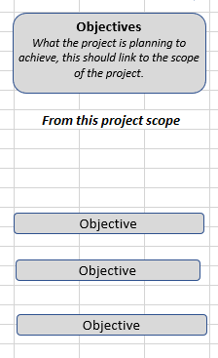
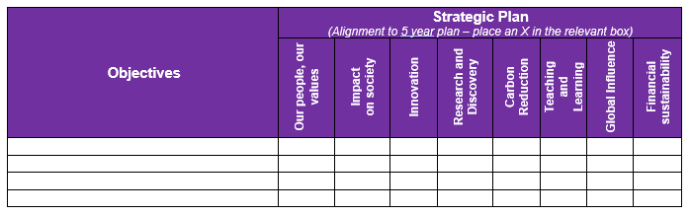
Running benefit workshops – Why?
Information for the Outline and Full Business Case; Objectives and Alignment to University Strategy
Transfer the objectives from the benefit map into this table and then an X put against the relevant driver to show the strategic fit of the project.

Slide 7
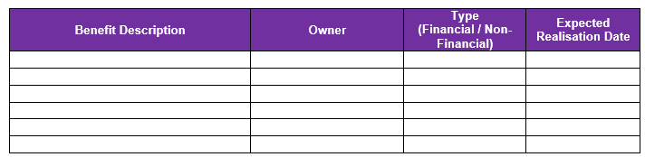
Running benefit workshops – Why?
Information for the Outline and Full Business Case; High-level Benefits
Populate the benefit log from the Benefit Toolkit and then copy the relevant information over.

Slide 8
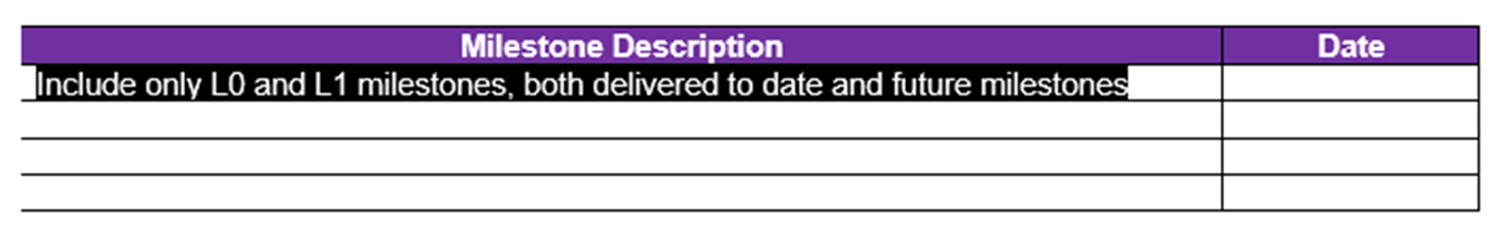
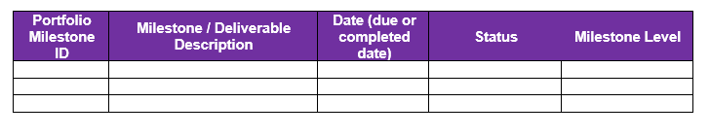
Running benefit workshops – Why?
Information for the Outline and Full Business Case; Key Milestones and Plan on a Page
From the benefit map you should include the changes (outcomes) as level 0 milestones and the deliverables (outputs) as level 1 milestones as they are critical to delivering improvements and realising the benefits.
Information for the PID; Milestones and Deliverables
From the benefit map you should include the changes (outcomes) as level 0 milestones and the deliverables (outputs) as level 1 milestones as they are critical to delivering improvements and realising the benefits.
This will help us to link benefits to milestones and enable us to track benefits at a portfolio level and manage dependencies

Slide 9
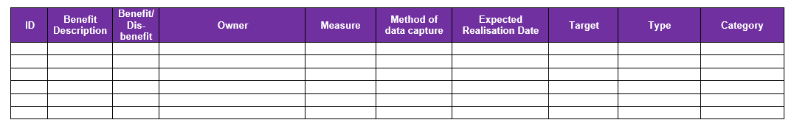
Running benefit workshops – Why?
Information for the PID; Benefit Map and Log
Cut and paste the benefit map and log over from the Benefit Toolkit – measures only need to be included at the end of the Design and Plan stage. The map shows the line of sight from the objectives of the project through to the University Strategic Goals. If the map is complex there are other ways to show this alignment or it can be simplified for presentation purposes.

Slide 10
Running benefit workshops – Who?
Who should attend a workshop
Business Leads – responsible for embedding the change and own the benefits
Subject Matter Experts (SMEs) – understand the business and current problems
PMO representative – independent guidance and advice

Slide 11
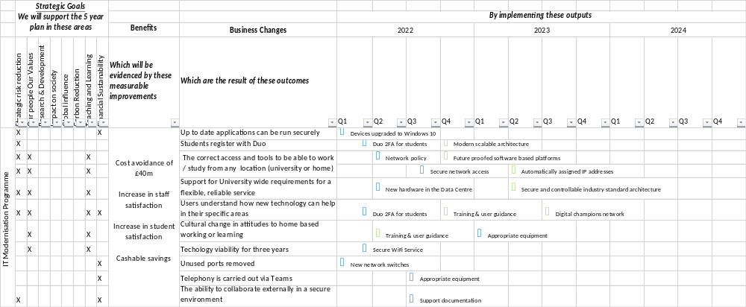
Running benefit workshops – What?

Slide 12
Any questions?
If anyone would like further information or would like help to run a benefit workshop please get in touch either by email or Teams.

